Slide 1
Hands-On Session on Linear Regression
By- Bhuvanjeet Singh Gandhi

Slide 2
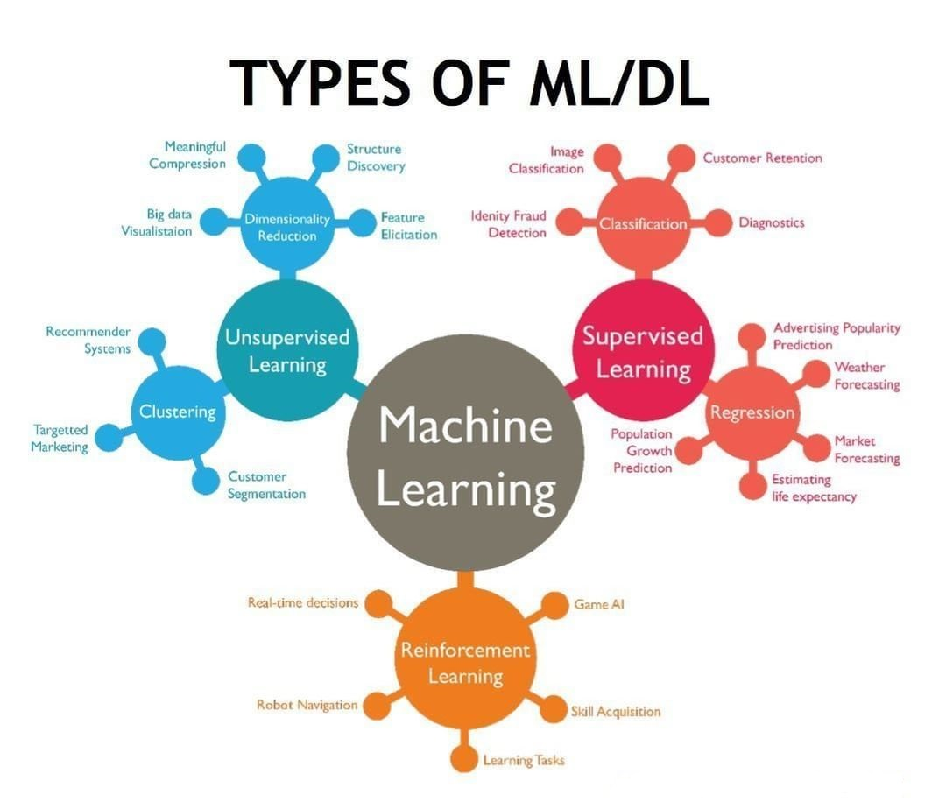

Slide 3
Overview:
Today’s webinar is divided into 2 parts :
Part I - Linear Regression Understanding
Part II- Hands-On Session on Jupyter Notebook

Slide 4
PART - I
What is Linear Regression?
1- Linear Regression is a machine learning algorithm based on supervised learning (the machine learning task of learning a function that maps an input to an output based on example input-output pairs.)
2- It performs a regression task. Regression models a target prediction value based on independent variables. It is mostly used for finding out the relationship between variables and forecasting.
3- Different regression models differ based on – the kind of relationship between dependent and independent variables, they are considering and the number of independent variables being used -
=> When there is only 1 independent variable - Univariate or Simple Linear Regression , => When there are many independent variables - Multiple Linear Regression

Slide 5
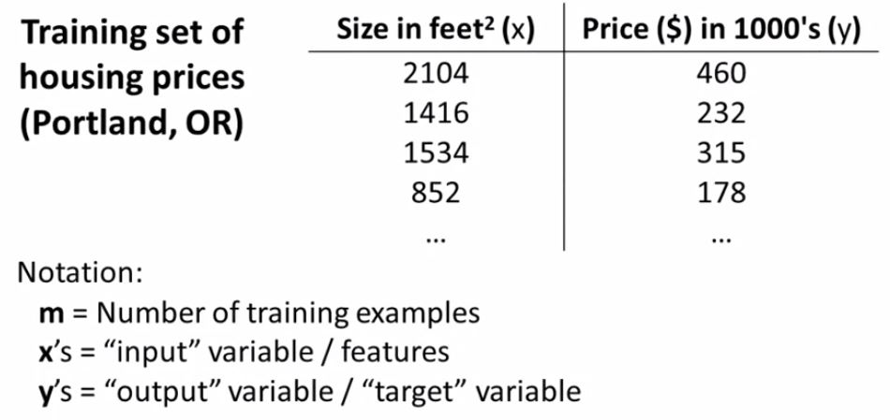
Let’s Dive Deeper :
Here , we are having a data set which has one independent variable/feature (x) - Size and a dependent/target variable (y):

Slide 6
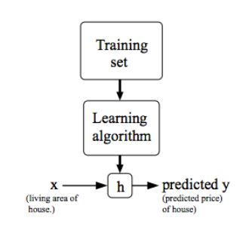
Model Representation:
Univariate Linear Regression:

Slide 7

Hypothesis Function:
So, the h in the flowchart represents ‘hypothesis function’ which maps from x’s to y’s.
Here, i.e. theta0 and theta1 are the parameters of this
hypothesis function.
=> h(x) is the predicted output value for the input x.
Also, we can see that the hypothesis function is of the form y=mx+c which is the equation of straight i.e. a linear line. So basically hypothesis function is nothing but a straight line.

Slide 8

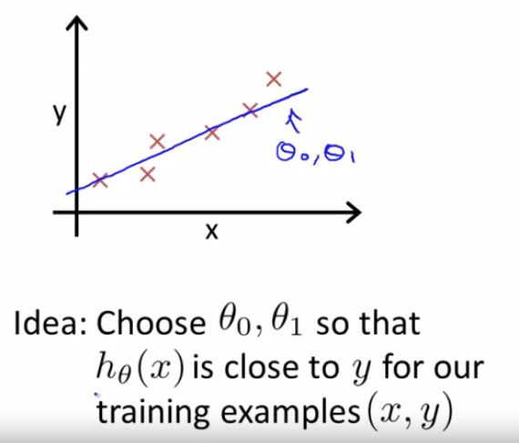
So now the question arises:
Here comes the role of Cost function : -

Slide 9
Cost Function:-
Cost function helps us to figure out how to fit the best possible straight line to the data.
We want to come up with such values of parameters theta0 & theta1 so that the straight line with which we come up is the line of best fit.

Slide 10

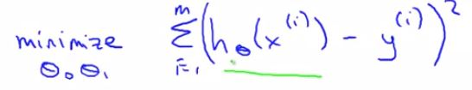

i.e.
We want to find such values of theta0 & theta1 which minimizes the difference between h(x) and y i.e we want the predicted value to be as close as possible to the actual target value.
Since there are m training examples,
i represents the ith training example i.e. for first training example, i=1 and so on.
The cost function is defined as: -

Slide 11

So, now we have understood that we want to find such values of theta0 & theta1 so as to minimize the cost function J(theta0,theta1).
So , our overall optimization objective is to minimize the cost function.

Slide 12
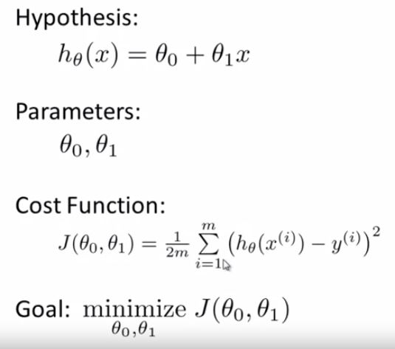
Let’s do a quick recap:

Slide 13
Now the question arises:
How to find such values of parameters theta0 and theta1 which minimizes the cost function J.
Here, Gradient Descent comes to rescue.

Slide 14
Gradient Descent
So, to find(update) the parameters, we will be using of an optimization algorithm known as gradient descent.
Gradient descent is best used when the parameters cannot be calculated analytically (e.g. using linear algebra) .
This is always the case in machine learning problems since the real-life dataset has too many features and a large number of training examples which makes it almost impossible to calculate the parameters analytically.

Slide 15
Basic Idea of Gradient Descent:
Start with some initial guesses of theta0 and theta1 ,
Say theta0 = 0 & theta1 = 0
Keep changing theta0 & theta1 a little bit to reduce the cost function J(theta0,theta1) until we hopefully end up at a local minimum.

Slide 16
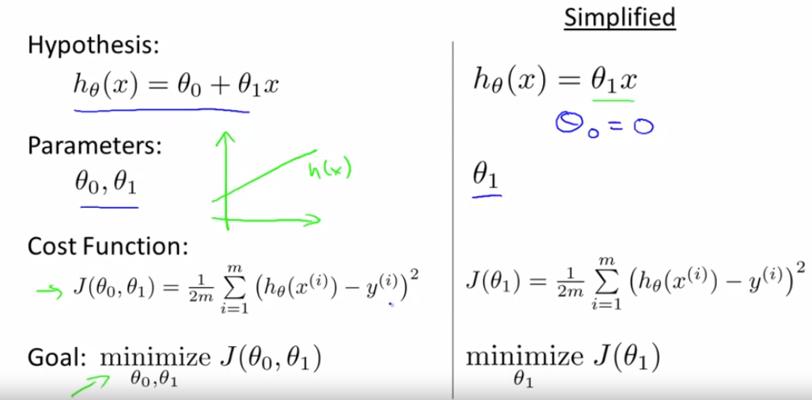
For the ease of understanding, let theta0 = 0
And let m=3 :
(x1,y1) = (1,1) ; (x2,y2) = (2,2) ; (x3,y3) = (3,3)

Slide 17
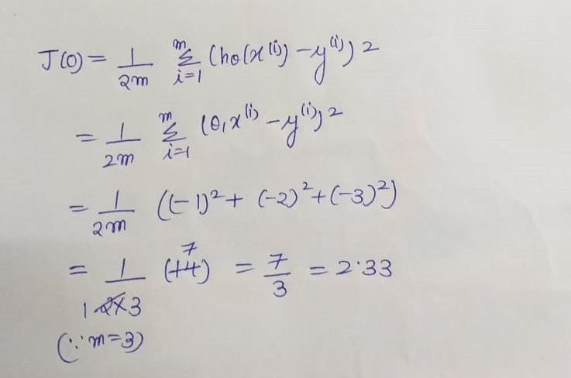
Case 1: Let theta1=0 :

Slide 18
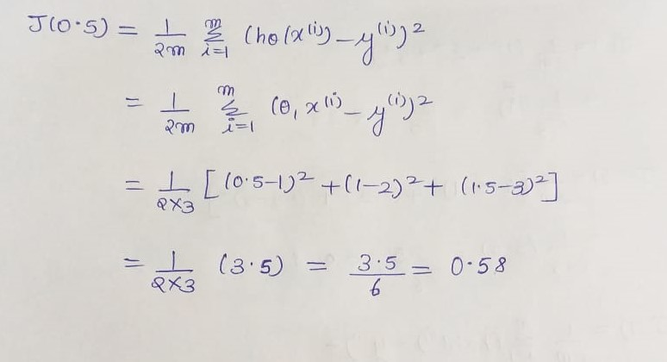
Case 2: Let theta1=0.5 :

Slide 19
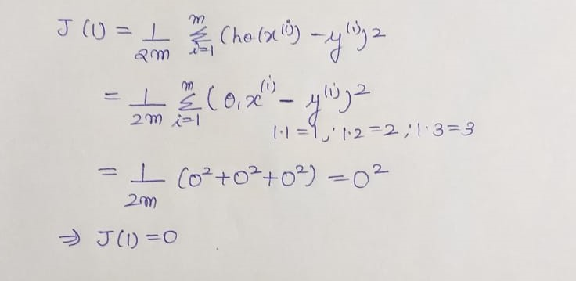
Case 3: Let theta1=1

Slide 20
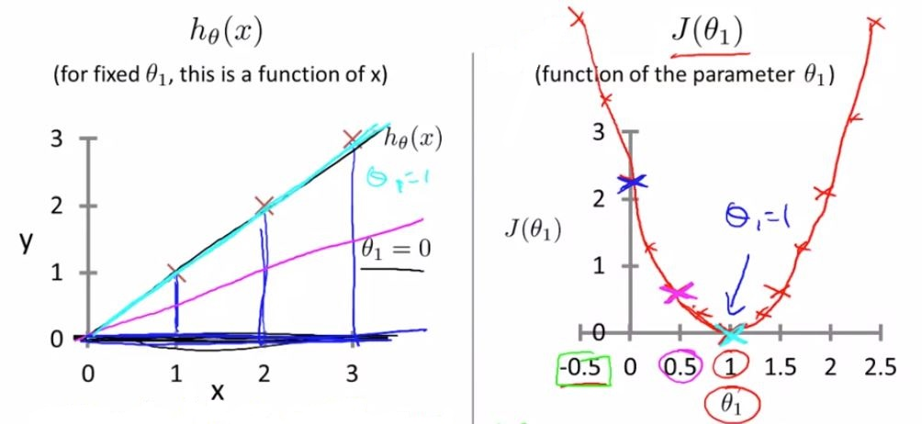

Slide 21
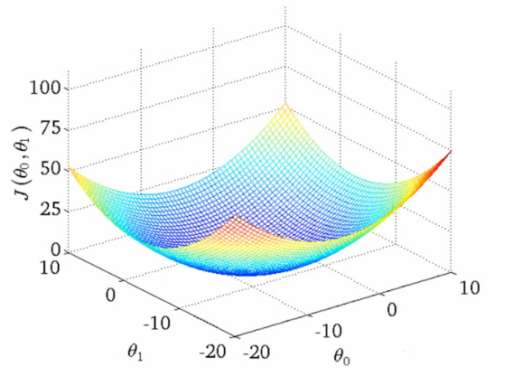
Now, suppose we now want to find out the values of both the parameters theta0 and theta1 , then:
The plot of cost function will look like:

Slide 22
Remember:
Cost function for linear regression is convex shaped i.e. it has no local optima , only 1 global optima, so it will always converge to global optima.

Slide 23
Summing it all up:
Hypothesis function
Cost Function
Gradient Descent
From gradient descent we will find such values of theta0 and theta1 which minimizes the cost function.
On placing these parameter values in hypothesis function, we will get the predicted output value.

Slide 24
PART - II
Hands-On Session
Dataset :- https://www.kaggle.com/vikrishnan/boston-house-prices
If you want to follow along :-
Github repo :- https://github.com/Bhuvanjeet/Boston-House-Price-Prediction

Slide 25
** Head Over to Jupyter Notebook **

Slide 26
Thank You for being such an amazing audience

